Slide 1

Hands on with Hadoop
Naren Thilla
Feb 26th 2014

Slide 2


Session -3: HDFS
Naren Thilla
Apr 28th 2015

Slide 3
Hadoop - Summary
 | Traditional RDBMS | Hadoop MR | Spark
Scale | GB | PetaBytes/ExaBytes | ExaBytes
Access | Interactive, Batch | Batch | Interactive & Batch
Updates | Read & Write often | Write once, Read many times (Coherence model) | Write once, Read many times (Coherence model)
Transaction Support | ACID | None | None
Schema Support | Schema-on-write | Schema-on-read | Schema-on-read
Integrity | High | Low (Eventually Consistent) | Low (Eventually Consistent)
Performance | Nonlinear scaling | Linear Scaling | Linear Scaling
Data Type | Structured | Structured Unstructured & Semi-structured | Structured Unstructured & Semi-structured

Slide 4

Nodes, Rack & Cluster
Cluster
Rack- n
Rack- 1
Rack- 2
Node - 1
....
....
....
....
Node - 30

Slide 5

HDFS Design Considerations
Works on top of existing File System.
Think FAT 32 or ext fs
Very Large Distributed File System. Works best with large files
10K nodes, 100 million files, 10PB
Handles disk & node failures natively
Files are replicated to handle hardware failure
Detect failures and recover from them
Sequential Data Access over Random Data Access
Files are chunked into “blocks”.
Block size of 64 MB size typical, 128 MB with Hadoop 2.0.
256 MB not uncommon. (512 b in MS-Dos & 4 KB in Unix)
A small file (say 1MB) occupies only 1MB of disk space and not 128MB
Data Coherency (when flush does not flush, but hflush does –)
Waits for the full block to be written.
Data Streaming
Write-once-read-many access model
Client expected to work on large dataset (vs. accessing the first or another tiny record)
Multiple Writers not supported. Always single writer with an append-only mode.
Provides very high aggregate bandwidth
Notes:
Large file size because seeks are more expensive. Large and sequential file access minimizes seek time and increases throughput.
Small files do not occupy the entire 64 MB.

Slide 6
The Importance of Block Design
Why Blocks?
Facilitates Redundancy
A single file can be larger than the largest disk on the network !!
File (128 MB)
HDFS Block (64 MB)
FS Block (4KB)
FS Block (4KB)
HDFS Block (64 MB)
FS Block (4KB)
……
FS Block (4KB)
……
Node -1
Node -28
Notes:
Breaking down a file into multiple blocks ensures that they can be stored redundantly and
ensures that a single file can be bigger than the biggest disk.

Slide 7
Fault Tolerance in HDFS
Block – 1
Block – 2
Rack- 1
Rack- 2
Rack- n
Block – 1
Block –2
Node - 1
Block – 1
Block –1
....
Block –2
Block –2
....
....
....
Node - 30
Goals:
Maximize redundancy
Minimize Seek speed .
Leverage commodity Hardware
Notes:
Replication Factor = 3 here.
Piping concept

Slide 8
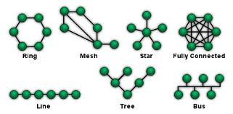
HDFS and Topology Awareness
Name Node
Stores the metadata of HDFS files and Blocks
Provides single namespace for the entire cluster
Maps the file/directory name to blocks
Slightly more expensive hardware.
Contains FSImage, Edit Log and In-memory metadata (change log & persistent image)
An In –memory construction of the FS tree (metadata) is maintained and is synced up whenever there is an edit log change, but is NOT persisted (this is done to speed things up)
All client interact with the in-memory representations of the Metadata.
The FS Image contains a serialized map of the file and directory inodes ,
Data Node
Node where the actual blocks are stored.
“Heartbeats” with the actual Name Node.
Cheaper Hardware
Deals with blocks
hdfs fsck / -files –blocks
Qn: I want to store Billions of small files. Can I?
Is HDFS tuned for small jobs such as 1 map job or low transformation jobs? (Argue around HDFS’ seek vs. transfer rate (seek speed (say 10 ms) is aimed at 1% of transfer speed)
Notes:
No secondary Name node in Hadoop 1.0. However, saves the configuration in a duplicate location. Possible to resurrect the name node, but “availability” loss of 20 min or so.
Secondary Name Node works as a passive standby in 2.0 No Hot standby.
Result? Data loss is inevitable.

Slide 9
Namenode Failures and Safegaurding
Backup in another mounted FS (this persistence is atomic and synchronous)
Secondary Name Node
Does the checkpoint merging of Edit Log with Namespace and persists a more accurate snapshot of the FS Images.
Requires large CPU
Lags the primary name node. Data loss almost certain
Safe Mode
When the primary crashes or when Hadoop is restarted, it takes time to reconstruct the fsimage from the individual data nodes. The system then goes into safe-mode.
Federated Primary Name Node
HDFS HA
Provides Hot Standby

Slide 10
Client Interaction
Checkpoint Node
Metada: FsImage, Edit Logs
Edits & fsimage sync
Java Program (MR)
Name Node
Backup Node
Edits & fsimage backup
Heartbeat – 3 sec
Data Node-1
Data Node-3
Data Node-2
Data Node-4
Data Aware Clients
Clients can know the location of the blocks
Client accesses data directly from DataNode
http://hortonworks.com/blog/hdfs-metadata-directories-explained/

Slide 11
Name Node & Data Node
Name Node
keeps the metadata entirely in memory.
For this reason, small number of large files are better to maintain than large number of small files.
FSImage
Stores the inode details like modification time, access time, access permission, replication
Loaded only at start up (or during checkpoint sync - every 1 hour/1 million txn)
Edit Logs
This keeps tracking of each and every change that is being done on HDFS. (Like adding a new file, deleting a file, moving it between folders..etc)
data/dfs/name ├── current │ ├── VERSION │ ├── edits_0000000000000000001-0000000000000000007 │ ├── edits_0000000000000000008-0000000000000000015 │ ├── edits_0000000000000000016-0000000000000000022 │ ├── edits_0000000000000000023-0000000000000000029 │ ├── edits_0000000000000000030-0000000000000000030 │ ├── edits_0000000000000000031-0000000000000000031 │ ├── edits_inprogress_0000000000000000032 │ ├── fsimage_0000000000000000030 │ ├── fsimage_0000000000000000030.md5 │ ├── fsimage_0000000000000000031 │ ├── fsimage_0000000000000000031.md5 │ └── seen_txid └── in_use.lock
Use of higher configuration hardware (with large RAM) recommended.
Secondary Name Node
Checkpoints between Primary and itself
Not meant for HA
Data Node -> Maintains Data and Some Metadata related to the Name Node

Slide 12
Data Pipelining & Rebalancing
Data Pipelining:
Client retrieves a list of Data Nodes on which to place replicas of a block
Client writes block to the first Data Node
The first Data Node forwards the data to the next node in the Pipeline
When all replicas are written, the Client moves on to write the next block in file
Rebalancer:
By default, the Name node, distributes the load across all the Data Nodes.
When a new node(s) is introduced and when rebalancer is enabled, shuffling of blocks happens in the background

Slide 13
HDFS – Command Line Interface
Hadoop fs <args>
Hadoop fs –ls
Hadoop fs -copyFromLocal file://wc.txt hdfs://localhost/user/hue/wc.txt
hadoop fsck / -files -blocks
https://hadoop.apache.org/docs/r0.18.3/hdfs_shell.html

Slide 14
Programming with HDFS
https://sites.google.com/site/hadoopandhive/home/hadoop-how-to-read-a-file-from-hdfs

Slide 15
The Future of HDFS
Innovations within Data Grid
Parquet (http://parquet.apache.org/)
Tachyon (`BDAS)- http://tachyon-project.org/
https://gigaom.com/2012/07/07/why-the-days-are-numbered-for-hadoop-as-we-know-it/
Compute Grids decoupled from HDFS available - S3, HFDS, Ceph, Native FS (HBase, Hive, Cassandra, Mongo etc)
Similarly, HDFS decoupled from Hadoop Compute Grid (MR) available
Mesos, YARN(Hadoop), Spark – Native,
Compute Grid (MR )
Compute Grid (MR, Mesos, YARN, Spark )
Data Grid (HDFS)
Data Grid (HDFS, S3, Hive, Cassandra, Mongo, Native FS)
Note: HDFS is NOT the only FS for Hadoop. Local FS, S3 are all available File Systems for Hadoop.
org.apache.hadoop.fs.FileSystem (is an abstract class !)

Slide 16


Slide 17
Map Reduce - Introduction
In Hadoop 1.0, MR was Co-designed, co-developed & co-deployed with HDFS
MR represents the compute grid (and API) of Hadoop.
Based on pipelining concept
It works like a Unix pipeline
cat input | grep | sort | uniq -c | cat > output
Input | Map | Shuffle & Sort | Reduce | Output
A good fit for a lot of applications
Log processing
Web index building
Click Stream Processing
http://hortonworks.com/hadoop-tutorial/how-to-visualize-website-clickstream-data/
Job Tracker
Moves code to the Task Tracker
Resource Management
Task Tracker Assignment (move jobs closer to where the data is). How does he know it?
Job Life Cycle Mgmt
Success/failure

Slide 18
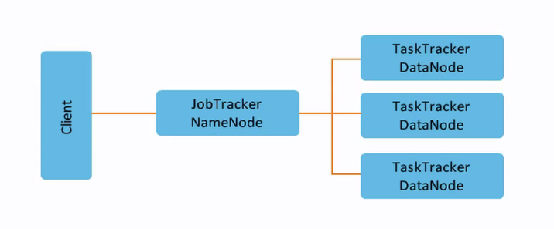
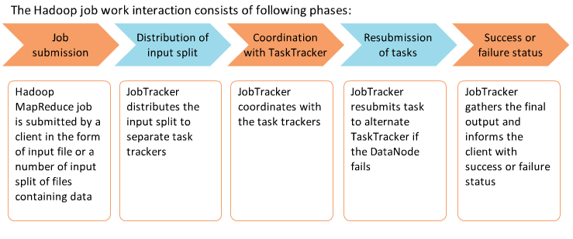
Job Tracker & Task Tracker

Slide 19
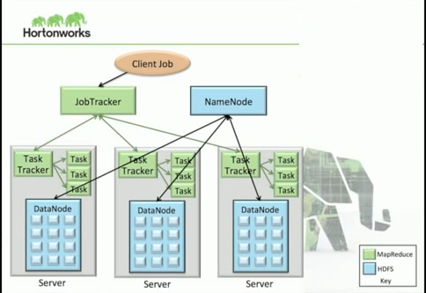
Task to Node Allocation
Source: Hortonworks

Slide 20
MR Functions: A conceptual framework
Map : Acts on a list and applies an operation to each item of the list (eg. Squaring an Array)
Operation is called as Transformation
Generic Notion map (List, foo() )
Equivalent to applying foo() in a for ….loop
Filter (fn) -> Iterates over the list and picks each item that meets the criteria defined by fn
Reduce (f) - >Reduces the list to a single item by applying the function (eg. f=sum())
http://en.wikipedia.org/wiki/MapReduce
Note: In the context of Hadoop, the Map operation results in a K,V pair. Why?

Slide 21
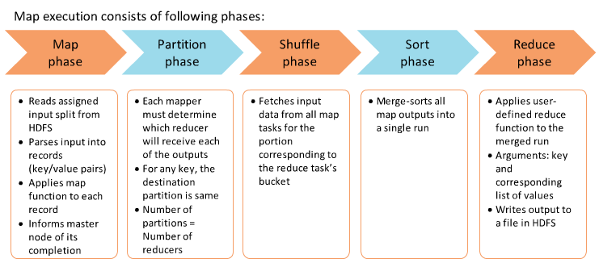
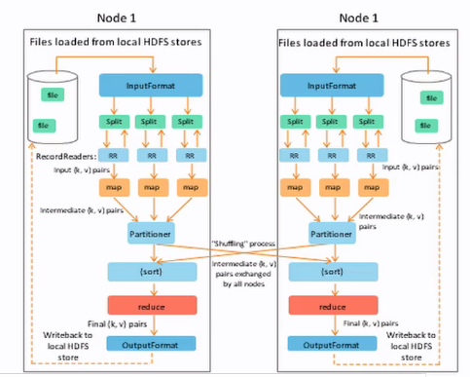
MR – Five Phases

Slide 22
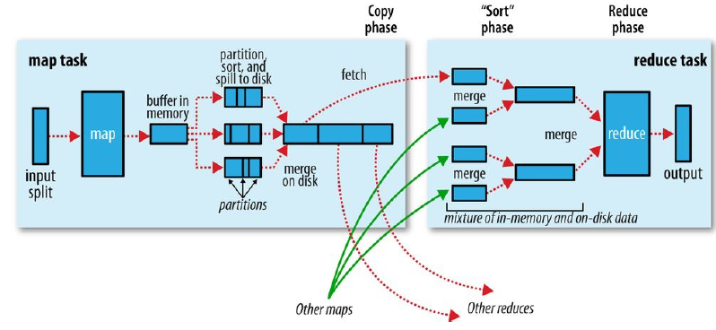
MR – Five Phases (Contd..)
Source: Hadoop – Definitive Guide (4th Edition)

Slide 23
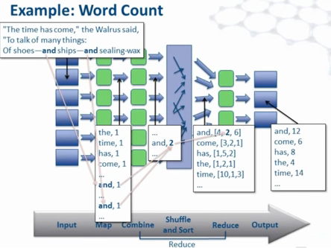
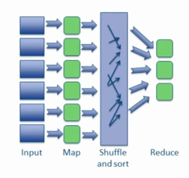
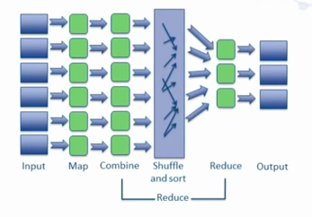
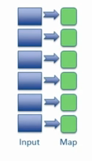
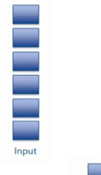
MR-Shuffle & Sort

